Slide 1
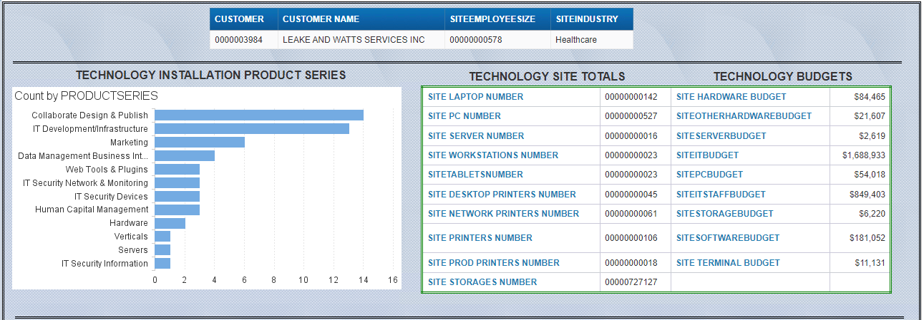
Technology Insights Report now available on CRM Accounts
Technology Insights is now available in CRM for 546K CRM Customer and Prospect accounts.
Technology Insights comprises of Company / Account level data as listed below:
Technology Installation
Provides Technology Hardware/Software information by Product Series, Product Category, Vendor Name, and Product
Tech Site Totals
Provides the number of technology hardware devices at that specific site (Computers, Servers, Printers, and Storage)
Tech Budget
Provides the IT Budgets for that specific site

Slide 2
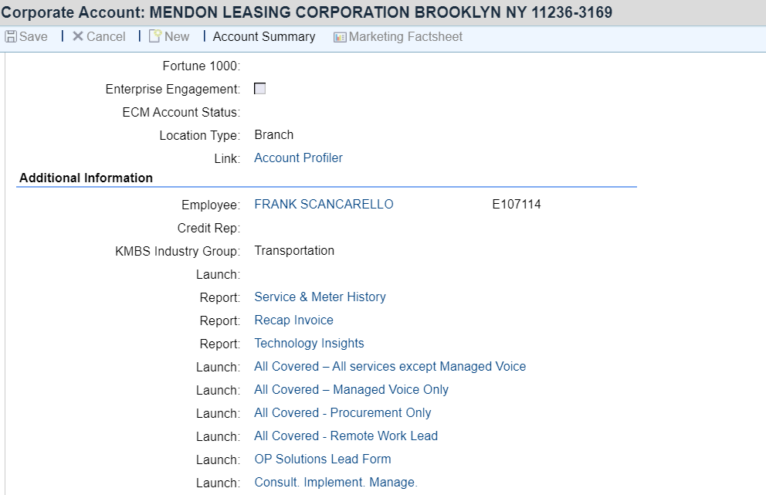
How to access / use Technology Insights Report
1. Logon to CRM 360 and navigate to the Customer / Prospect Account screen
2. Under Account Details tab find the Additional Information section and you will see ‘Report Technology Insights’
3. Click Technology Insights link to run report – this will launch a BOBJ report with the details if available.

Slide 3
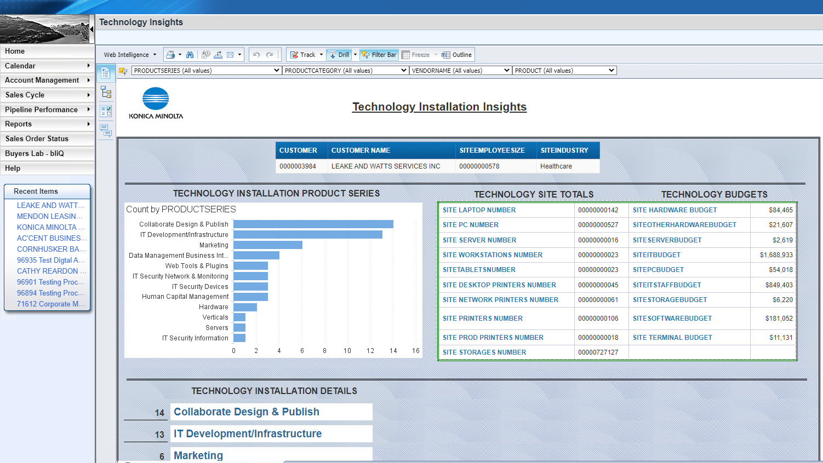
Technology Insights Report
An Embedded BOBJ Report appears within CRM 360 screen.
Click on Outline Button located on Report Option bar to enable Installation Details Drilldown.

Slide 4
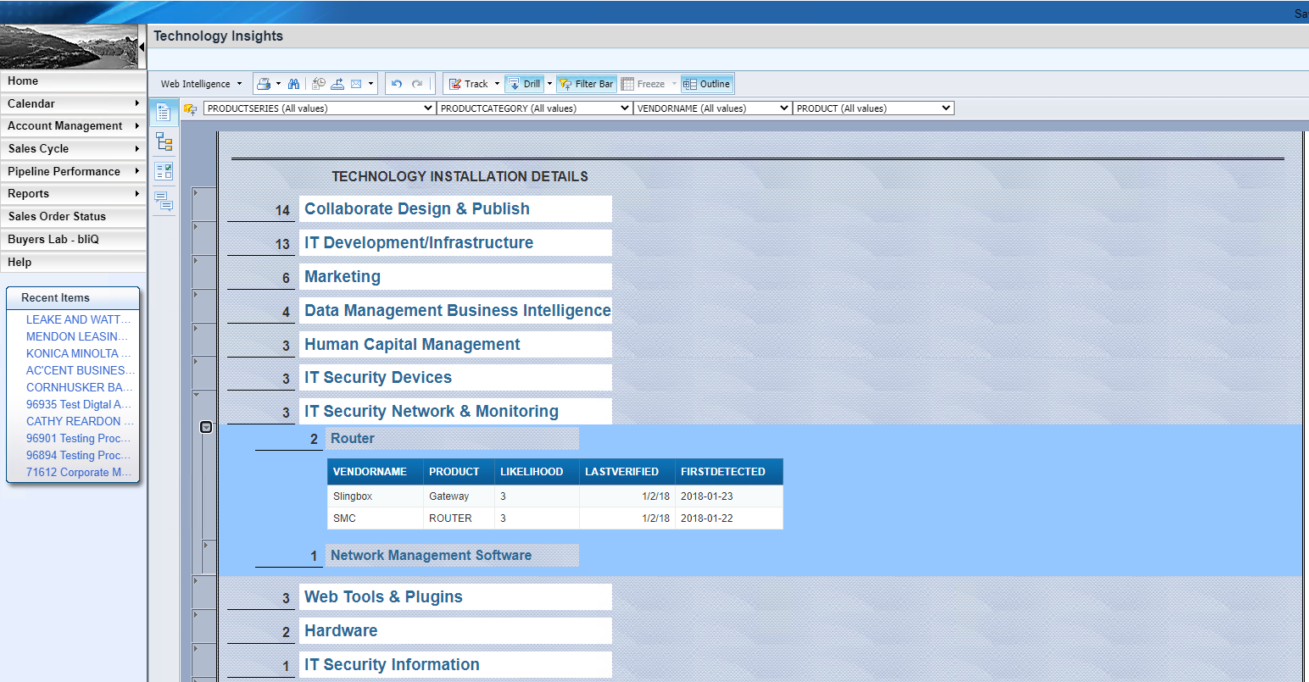
Technology Installation Drilldown
With Outline enabled you can drilldown Technology Installation by clicking section button next to each Product Series. 2nd level provides Product Category, 3rd level will provide lowest level Vendor and Product information.

